Slide 1
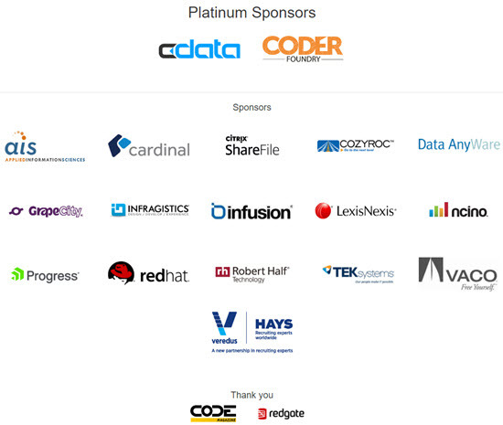


Slide 2
IoT for the Software Developer
Ian Hoppes @ianhoppes | https://github.com/ianhoppes http://www.ianhoppes.com

Slide 3
What is IoT?
The Internet of Things (IoT) is the network of physical objects - devices, vehicles, buildings and other items - embedded with electronics, software, sensors, and network connectivity that enables these objects to collect and exchange data.
Inexpensive, accessible hardware
Ubiquitous internet access
Cloud computing
Notes:
IoT is…
Next wave of innovation driven by
Inexpensive, accessible hardware
Ubiquitous internet access
Cloud computing

Slide 4
Why should you be interested?
20,800,000,000 “Things” By 2020
Industrial IoT (IIoT)
Manufacturing
Healthcare
Energy
Home Automation
Retail
Hobbyists/Makers
Transportation
Autonomous Vehicles
Logistics
Automotive
Environmental Sensing
Agriculture
Smart Buildings
Notes:
Gartner, Inc. forecasts that 6.4 billion connected things will be in use worldwide in 2016, up 30 percent from 2015, and will reach 20.8 billion by 2020.
This year 5.5 million new things will get connected every day.
Huge business opportunity both in the IoT space and transforming existing companies by using IoT
Great opportunity for us as software developers to get involved

Slide 5
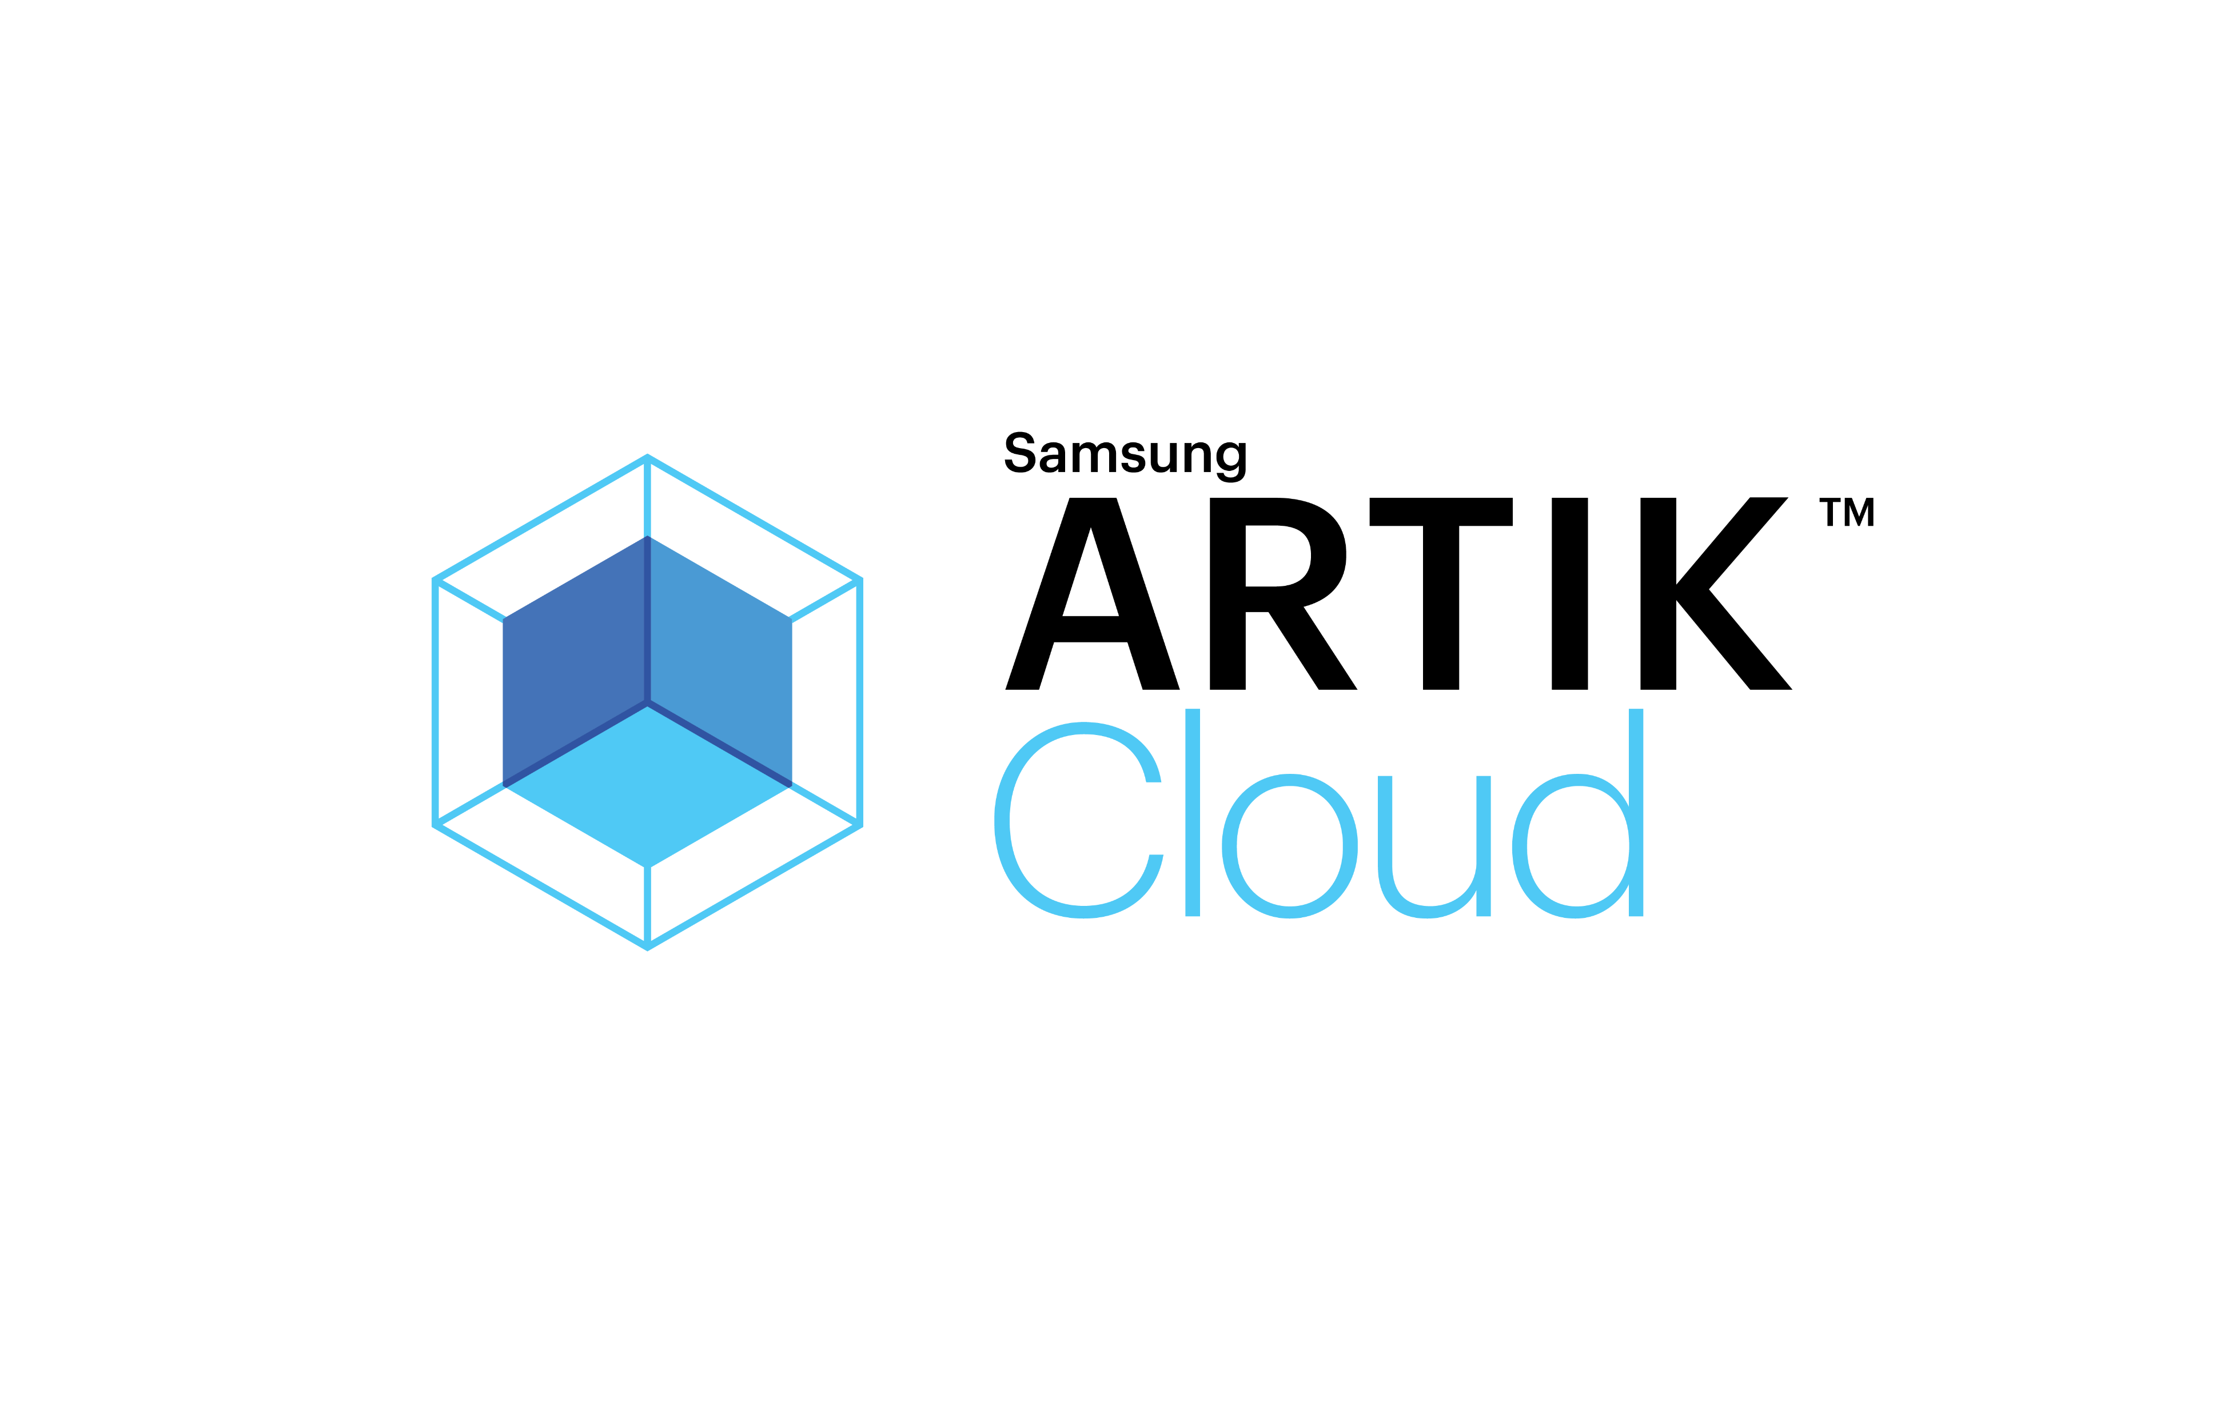




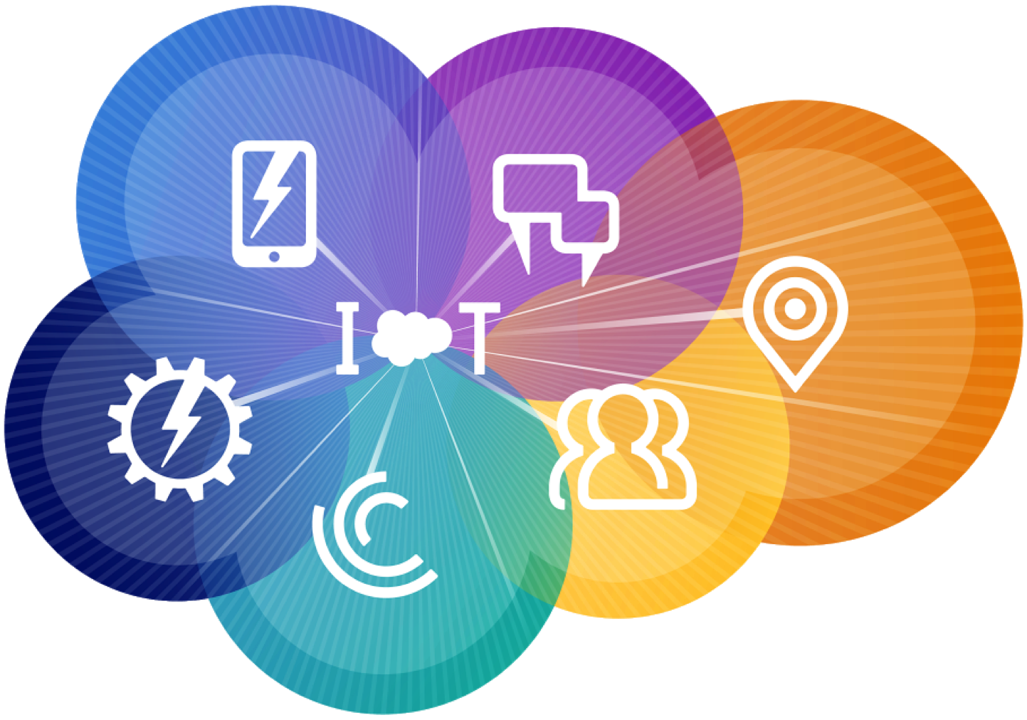





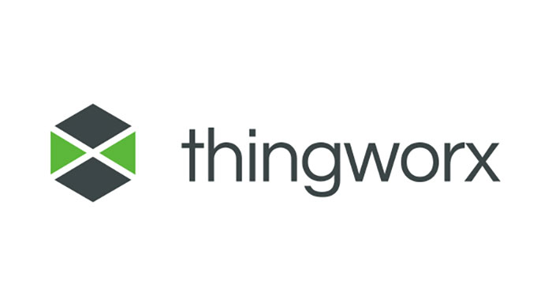
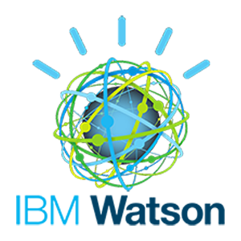



Cloud Platforms
Notes:
Hardware = Particle
Full featured = Microsoft Azure IoT Suite

Slide 6
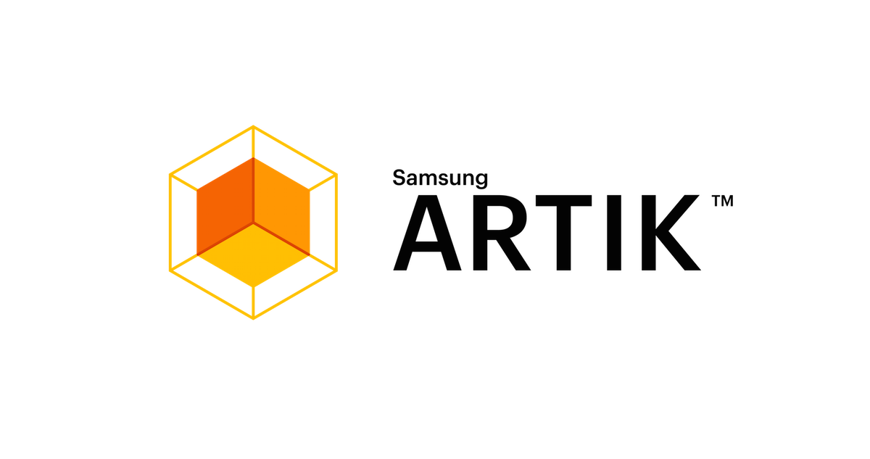

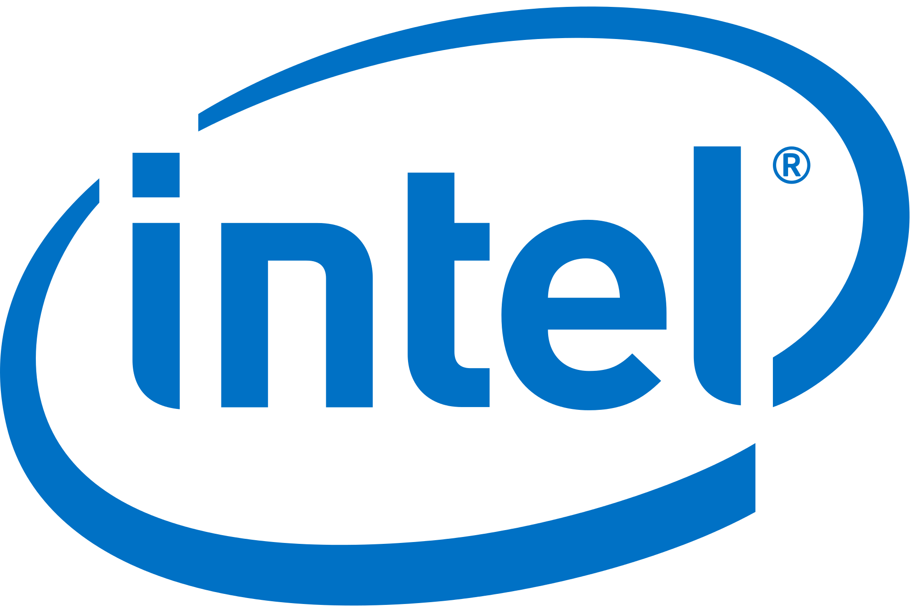


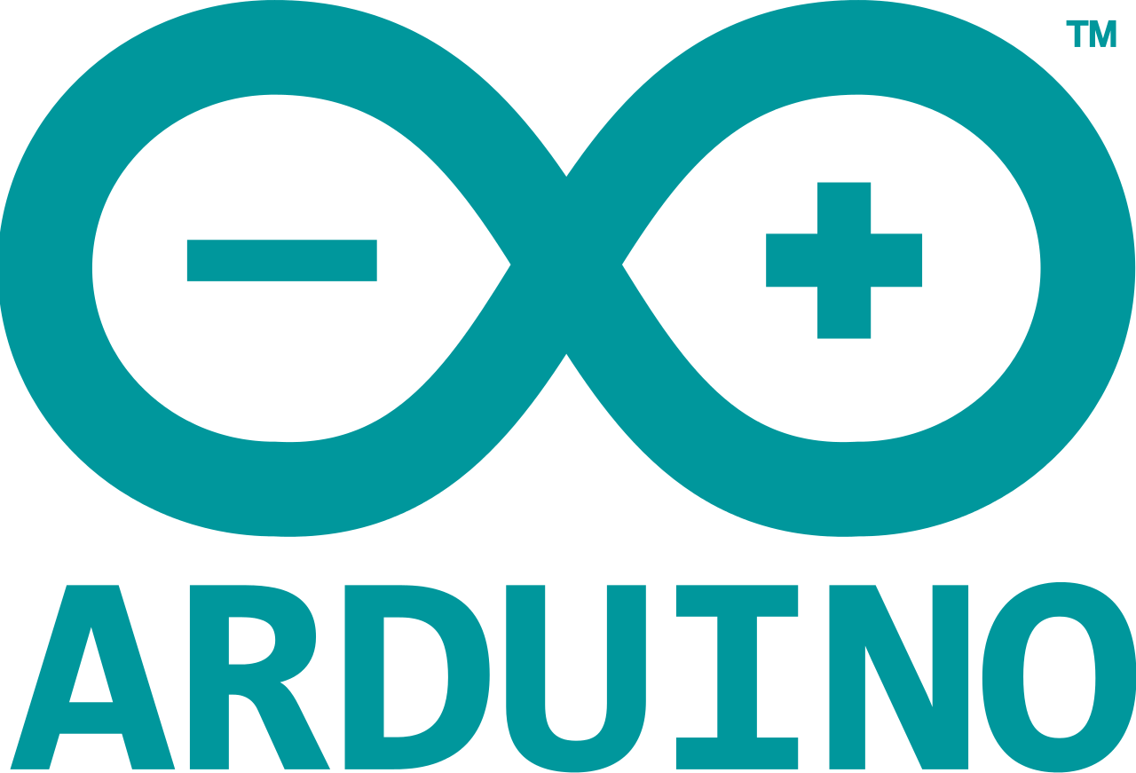
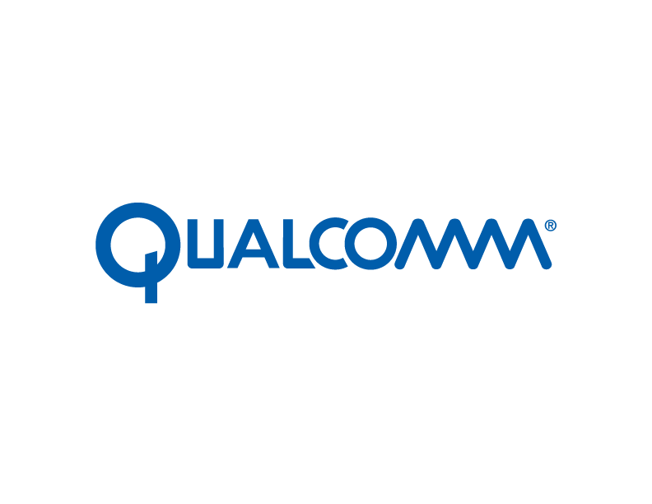








Devices
Notes:
Simple as a temperature sensor or as complex as real-time telemetry data from manufacturing facilities around the world
All major chip manufacturers are developing new products and positioning existing for the IoT market

Slide 7
IoT Solution Components
Devices
Large #
Diverse locations
Device Management
Collect & Store Data
Act on Data
Analyze Data
Different Types
Notes:
Device, Device management, collect/store data, analyze data, act on the data
Device can be single sensor or gateway device
Not just one device…
Device management = monitor, secure, OTA updates
Large amounts of data
Analyze in real-time (Azure Stream Analytics)
Turning the data into actionable business intelligence (machine learning and
Cloud makes it possible

Slide 8
IoT Solution Components
Devices
Device Management
Monitoring
Security
Collect & Store Data
Act on Data
Analyze Data
OTA Updates
Notes:
Device, Device management, collect/store data, analyze data, act on the data
Device can be single sensor or gateway device
Not just one device…
Device management = monitor, secure, OTA updates
Large amounts of data
Analyze in real-time (Azure Stream Analytics)
Turning the data into actionable business intelligence (machine learning and
Cloud makes it possible

Slide 9
IoT Solution Components
Devices
Device Management
Collect & Store Data
Large amount
Storage options
Act on Data
Analyze Data
Centralize
Notes:
Device, Device management, collect/store data, analyze data, act on the data
Device can be single sensor or gateway device
Not just one device…
Device management = monitor, secure, OTA updates
Large amounts of data
Analyze in real-time (Azure Stream Analytics)
Turning the data into actionable business intelligence (machine learning and
Cloud makes it possible

Slide 10
IoT Solution Components
Devices
Device Management
Collect & Store Data
Act on Data
Analyze Data
Real-time
Machine learning
Visualizations
Notes:
Device, Device management, collect/store data, analyze data, act on the data
Device can be single sensor or gateway device
Not just one device…
Device management = monitor, secure, OTA updates
Large amounts of data
Analyze in real-time (Azure Stream Analytics)
Turning the data into actionable business intelligence (machine learning and
Cloud makes it possible

Slide 11
IoT Solution Components
Devices
Device Management
Collect & Store Data
Act on Data
Analyze Data
Predictive
Reactive
Insights
Notes:
Device, Device management, collect/store data, analyze data, act on the data
Device can be single sensor or gateway device
Not just one device…
Device management = monitor, secure, OTA updates
Large amounts of data
Analyze in real-time (Azure Stream Analytics)
Turning the data into actionable business intelligence (machine learning and Cloud makes it possible)

Slide 12
IoT Solution Components
Devices
Large #
Diverse locations
Device Management
Monitoring
Security
Collect & Store Data
Large amount
Storage options
Act on Data
Analyze Data
Real-time
OTA Updates
Machine learning
Visualizations
Centralize
Predictive
Reactive
Insights
Different Types
Hardware Software

Slide 13
Development Boards
Microcontroller (MCU) | Single Board Computer/SoC
Embedded OS/Firmware | General Purpose OS
Single purpose | Multitasking
GPIO | GPIO, USB, HDMI
Limited memory | More memory and storage
Faster boot/GPIO, smaller footprint, less power | Slower boot/GPIO, larger footprint, more power
<$5-$30 | $35-$350
C/C++ | JavaScript, C#, Python, C++
Notes:
Simplified

Slide 14
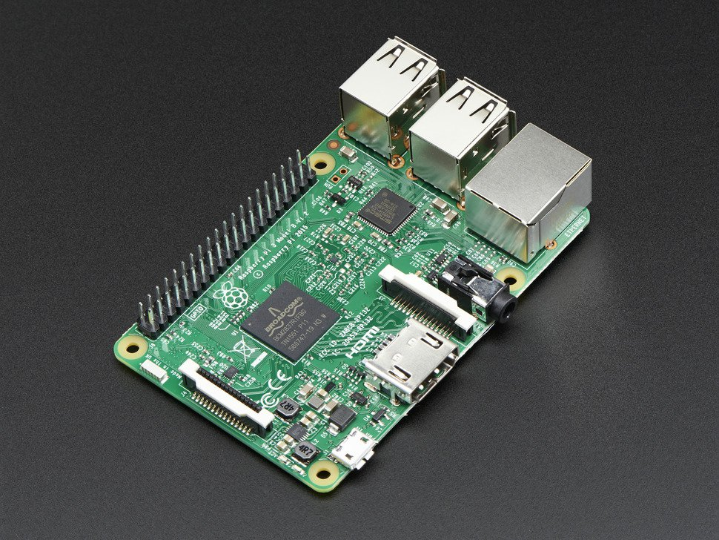
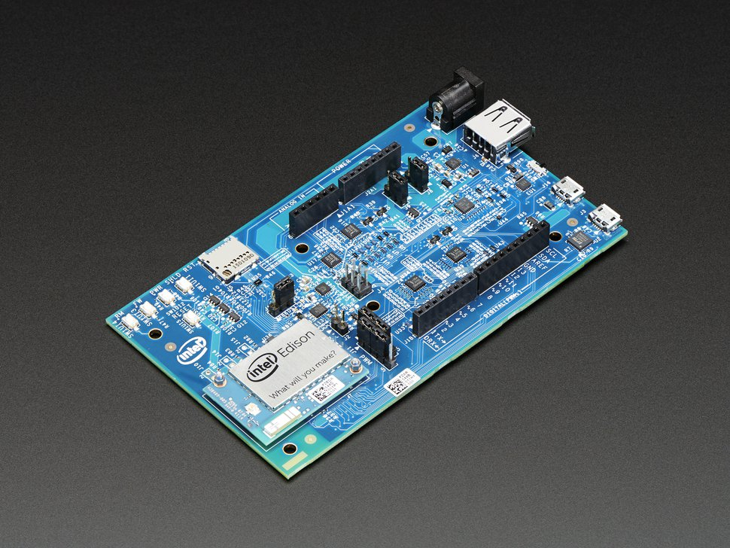
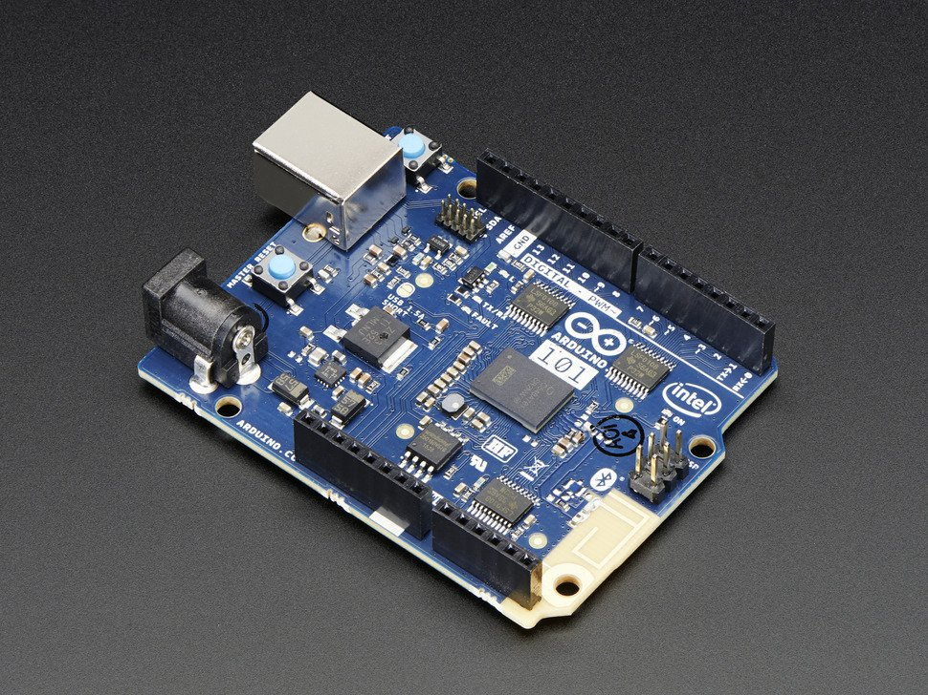
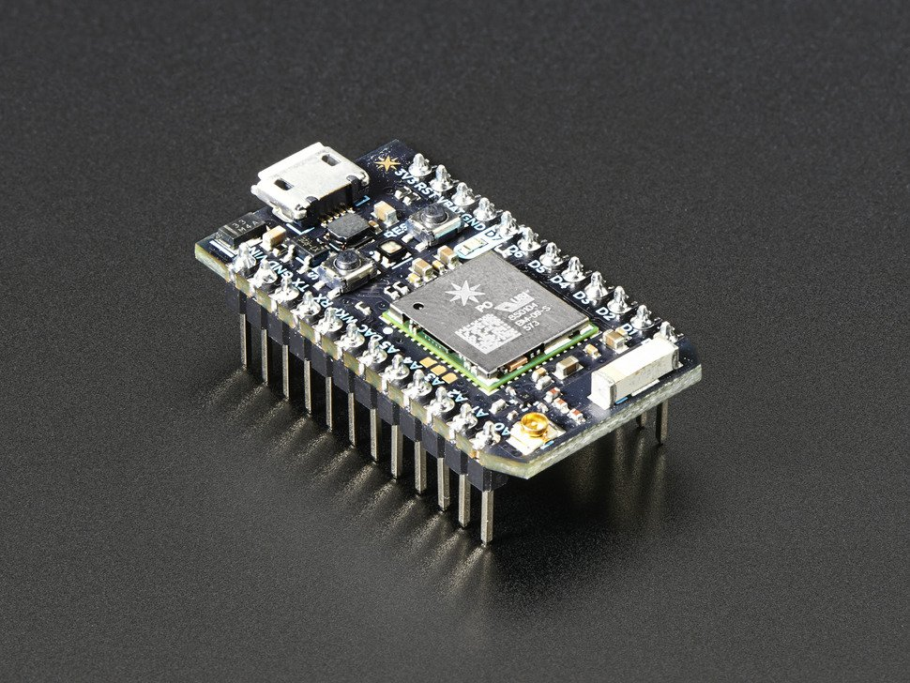
Board | Raspberry Pi 3 | Intel Edison | Arduino 101 | Particle Photon
Cost | $35 | $50/$110 | $40 | $19
Type | SBC | SoC | MCU | MCU
Voltage | 3.3V | 3.3V/5V | 3.3V | 3.3V
GPIO | 26 Digital | 20 Digital/6 Analog | 14 Digital/6 Analog | 8 Digital/6 Analog
WiFi | Yes | Yes | No | Yes
Bluetooth | Yes | Yes | Yes (LE) | No
OS | Windows 10 IoT/Linux | Yocto Linux | RTOS | FreeRTOS
Languages | .NET UWP C#, VB, JavaScript, C++ Python, Node.js | JavaScript, C++, Python | C++ | C++
IDE | Visual Studio | Intel XDK, Eclipse | Arduino Desktop/Cloud | Cloud/Desktop/CLI

Slide 15
Sensors
Breakouts
Purchase with headers
Read the data sheet
Voltage
Interface/Communications Protocol
Check manufacturer/vendor for sample code
Buy direct from China to save money
Notes:
3.3V vs 5V

Slide 16

Grove System
Plug-and-play
No soldering or resistors needed
Supports multiple dev boards
Wide variety of sensors
Well documented

Slide 17



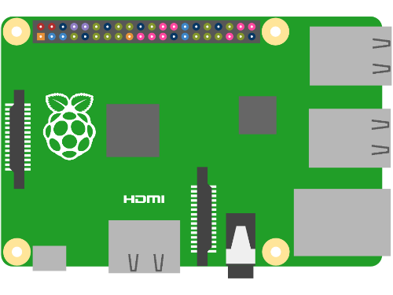
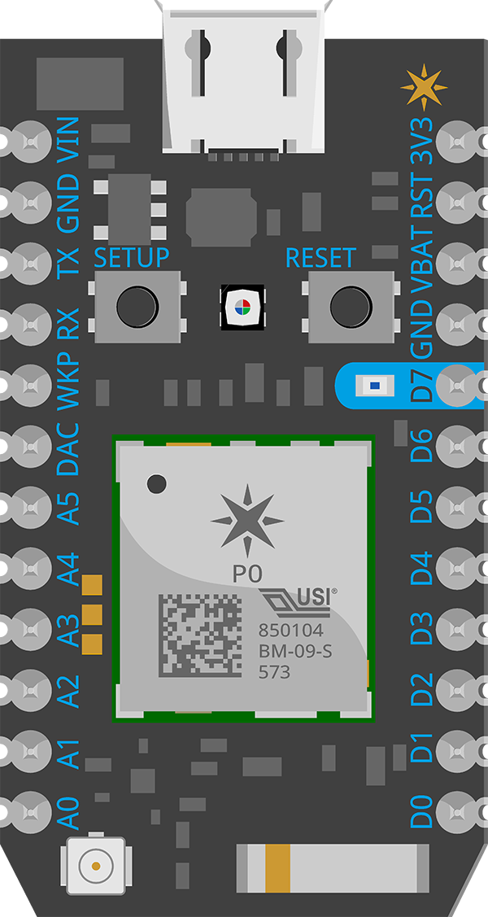
Demo
Azure IoT Suite
Particle Cloud

Slide 18


Thanks, Any Questions?
Pick up a “starter kit”
~$100
Adafruit.com
Sparkfun.com
Meetups
Hackster IoT Raleigh - http://www.meetup.com/Hackster-Raleigh/
Charlotte IoT - http://www.meetup.com/Charlotte-Internet-of-Things/
Twitter @ianhoppes
Notes:
Encourage you to pick up a maker kit
$100-$150 includes dev board and array of sensors
Come to a Meetup
Reach out to me on Twitter

